Slide 1

Angular Reactive Programming with RxJS
.NET

Slide 2
Reactive programming is an asynchronous programming paradigm concerned with data streams and the propagation of changes throughout an application.
https://en.wikipedia.org/wiki/Reactive_programming

Slide 3
Imperative vs Declarative Programming https://learn.microsoft.com/en-us/dotnet/standard/linq/functional-vs-imperative-programming
It’s important to note the difference between Imperative and Declarative programming.
Characteristic | Imperative approach | Functional approach
Programmers Goal | Perform tasks and track changes in data state. | Determine what transformations of data are needed.
State Changes | Important. | Non-existent.
Order of execution | Important. | Low importance.
Primary flow control | Loops, conditionals, and function/method calls. | Function calls, including recursion.
Primary unit of data manipulation | Instances of structures or classes. | Functions as first-class objects and data collections.

Slide 4
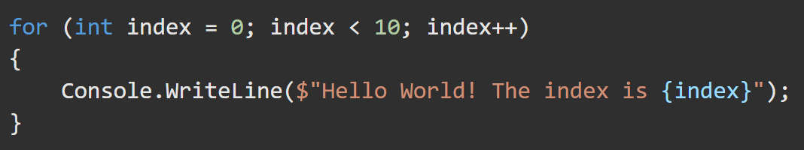
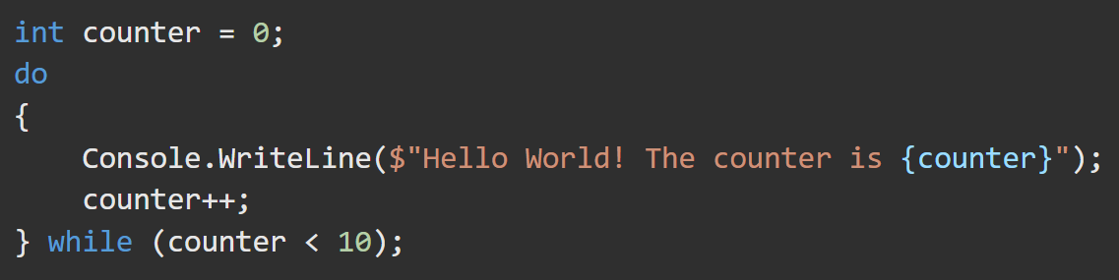
Imperative Programming https://learn.microsoft.com/en-us/dotnet/standard/linq/functional-vs-imperative-programming
In Imperative Programming, a developer writes code that specifies what the computer will do.
In OOP languages like C#, Visual Basic, C++, and Java, developers use Imperative Programming. The behavior and state of object types are paramount.
Language features like classes, interfaces, inheritance, and polymorphism are provided to maintain the state of data.
public class Person
{
// Constructor that takes no arguments:
public Person() { Name = "unknown"; }
// Constructor that takes one argument:
public Person(string name) { Name = name; }
// Auto-implemented readonly property:
public string Name { get; }
// Method that overrides base class ToString().
public override string ToString() { return Name; }
}

Slide 5
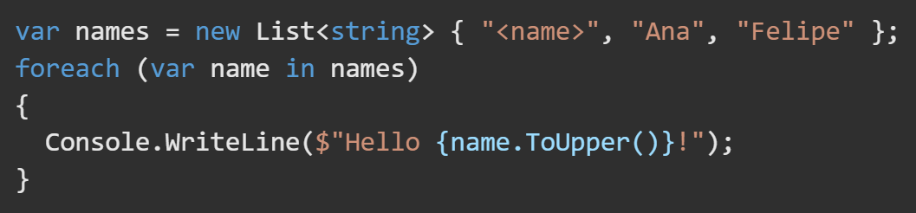
Functional Programming https://learn.microsoft.com/en-us/dotnet/standard/linq/functional-vs-imperative-programming
Declarative Programming involves composing a solution as a set of functions to be executed on the data set.
Functional programming avoids state and mutable data, and instead emphasizes the application of functions to collections of data.
Functional Programming is a form of Declarative Programming.
var someNumbers = { 4, 3, 2, 1 };
var processed = someNumbers
.Select(n => n * 2) // Multiply each number by 2
.Where(n => n != 6) // Keep all the results, except for 6
.OrderBy(n => n); // Sort in ascending order
var query2 = (from u in context.Users
where u.Id == value orderby u.Username select u)
.Skip(skip).Take(take);

Slide 6
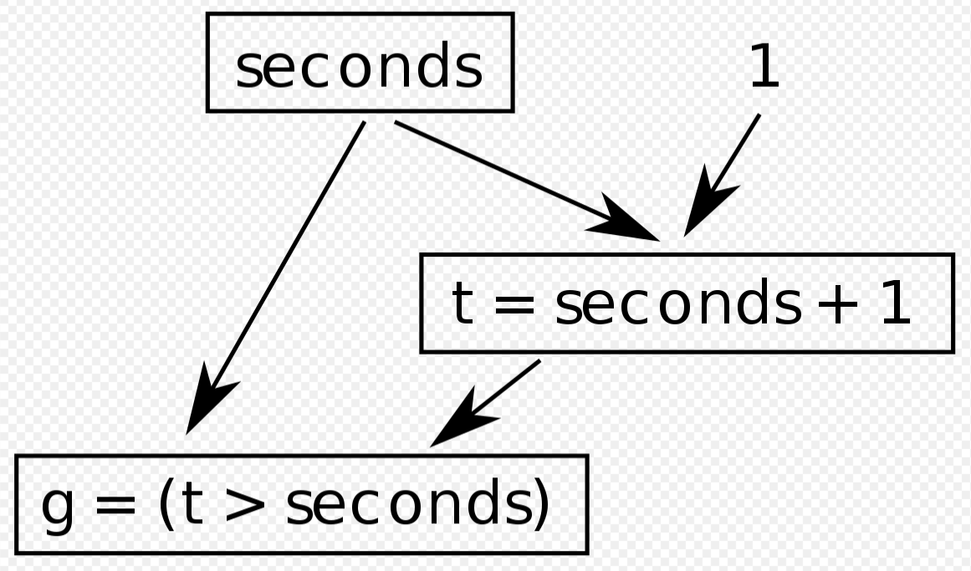
Reactive Programming – Overview https://en.wikipedia.org/wiki/Reactive_programming RedHatDeveloper5ThingstoKnowAboutReactiveProgramming
In Reactive Programming, it is possible to create dependencies between data and to automatically propagate changes to associated values when the base value changes.
The result of an evaluation is automatically updated whenever the values of the items that make up the expression change. The program does not have to re-execute the evaluation.
If C = A + B, when the value of A or B change, C also must change. In Reactive Programming, C is automatically changed when A or B change without the program having to specifically re-evaluate the expression.
There is often a propagation graph in which a change to one value will propagate to many other values down through levels of the graph.

Slide 7
Reactive Programming – Challenges https://en.wikipedia.org/wiki/Reactive_programming RedHatDeveloper5ThingstoKnowAboutReactiveProgramming
It is possible to have a propagation order that is not a natural consequence of the source program. In an asynchronous program, the expressions below may not execute in the same order every time.
As long as t = seconds + 1 evaluates first, then g will always evaluate to be true. But if g = (t > seconds) evaluates first (with the old value of t), then it will evaluate to be false.
Some reactive languages overcome this problem by using topological sorting expressions and updating values in topological order. This approach can delay the delivery of values.
In some cases, it is acceptable for values to be temporarily out of sync. Developers must be aware of this possibility.

Slide 8
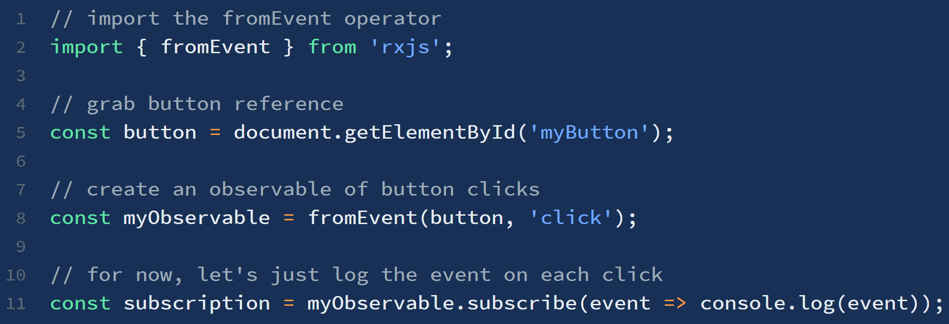
Observer Pattern https://en.wikipedia.org/wiki/Observer_pattern https://www.learnrxjs.io/learn-rxjs/concepts/rxjs-primer
The Observer Pattern is a software design pattern in which an object, called a Subject, maintains a list of its dependents, called Observers, and notifies them automatically of any state changes, usually by calling their “update” method. Angular uses the Observer Pattern.
The Observers are physically separated from, and have no control over, the emitted events of the Subject. This pattern is for processes in which data is not available to the CPU at startup,
but can arrive intermittently through HTTP requests, user input, etc.
In JavaScript (and TypeScript), libraries and frameworks exist to utilize the Observer Pattern. One such library is RxJS.

Slide 9
Subscriber Pattern
TODO

Slide 10
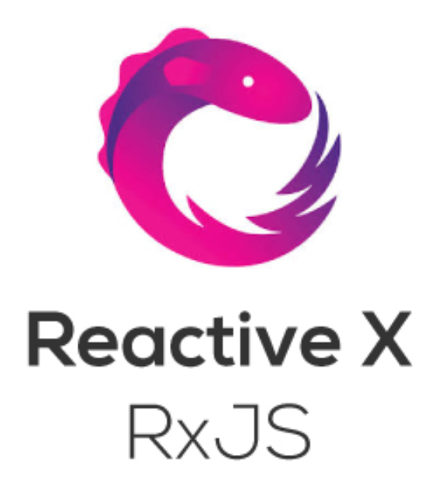

RxJS (Reactive eXtensions for JavaScript) https://www.learnrxjs.io/ https://rxjs-dev.firebaseapp.com/guide/overview
Learning RxJS and reactive programming involves a fundamental shift in mindset from an “Imperative” to a “Declarative” (“functional”) programming style.
The RxJS library allows using Observable “sequences” for asynchronous, event-based programs. RxJS has three main parts for working with sequences:
Observable - The core type.
Satellite types (Observer, Schedulers, Subjects) and
Operators (map, filter, reduce, every, etc) for handling async events as collections.

Slide 11
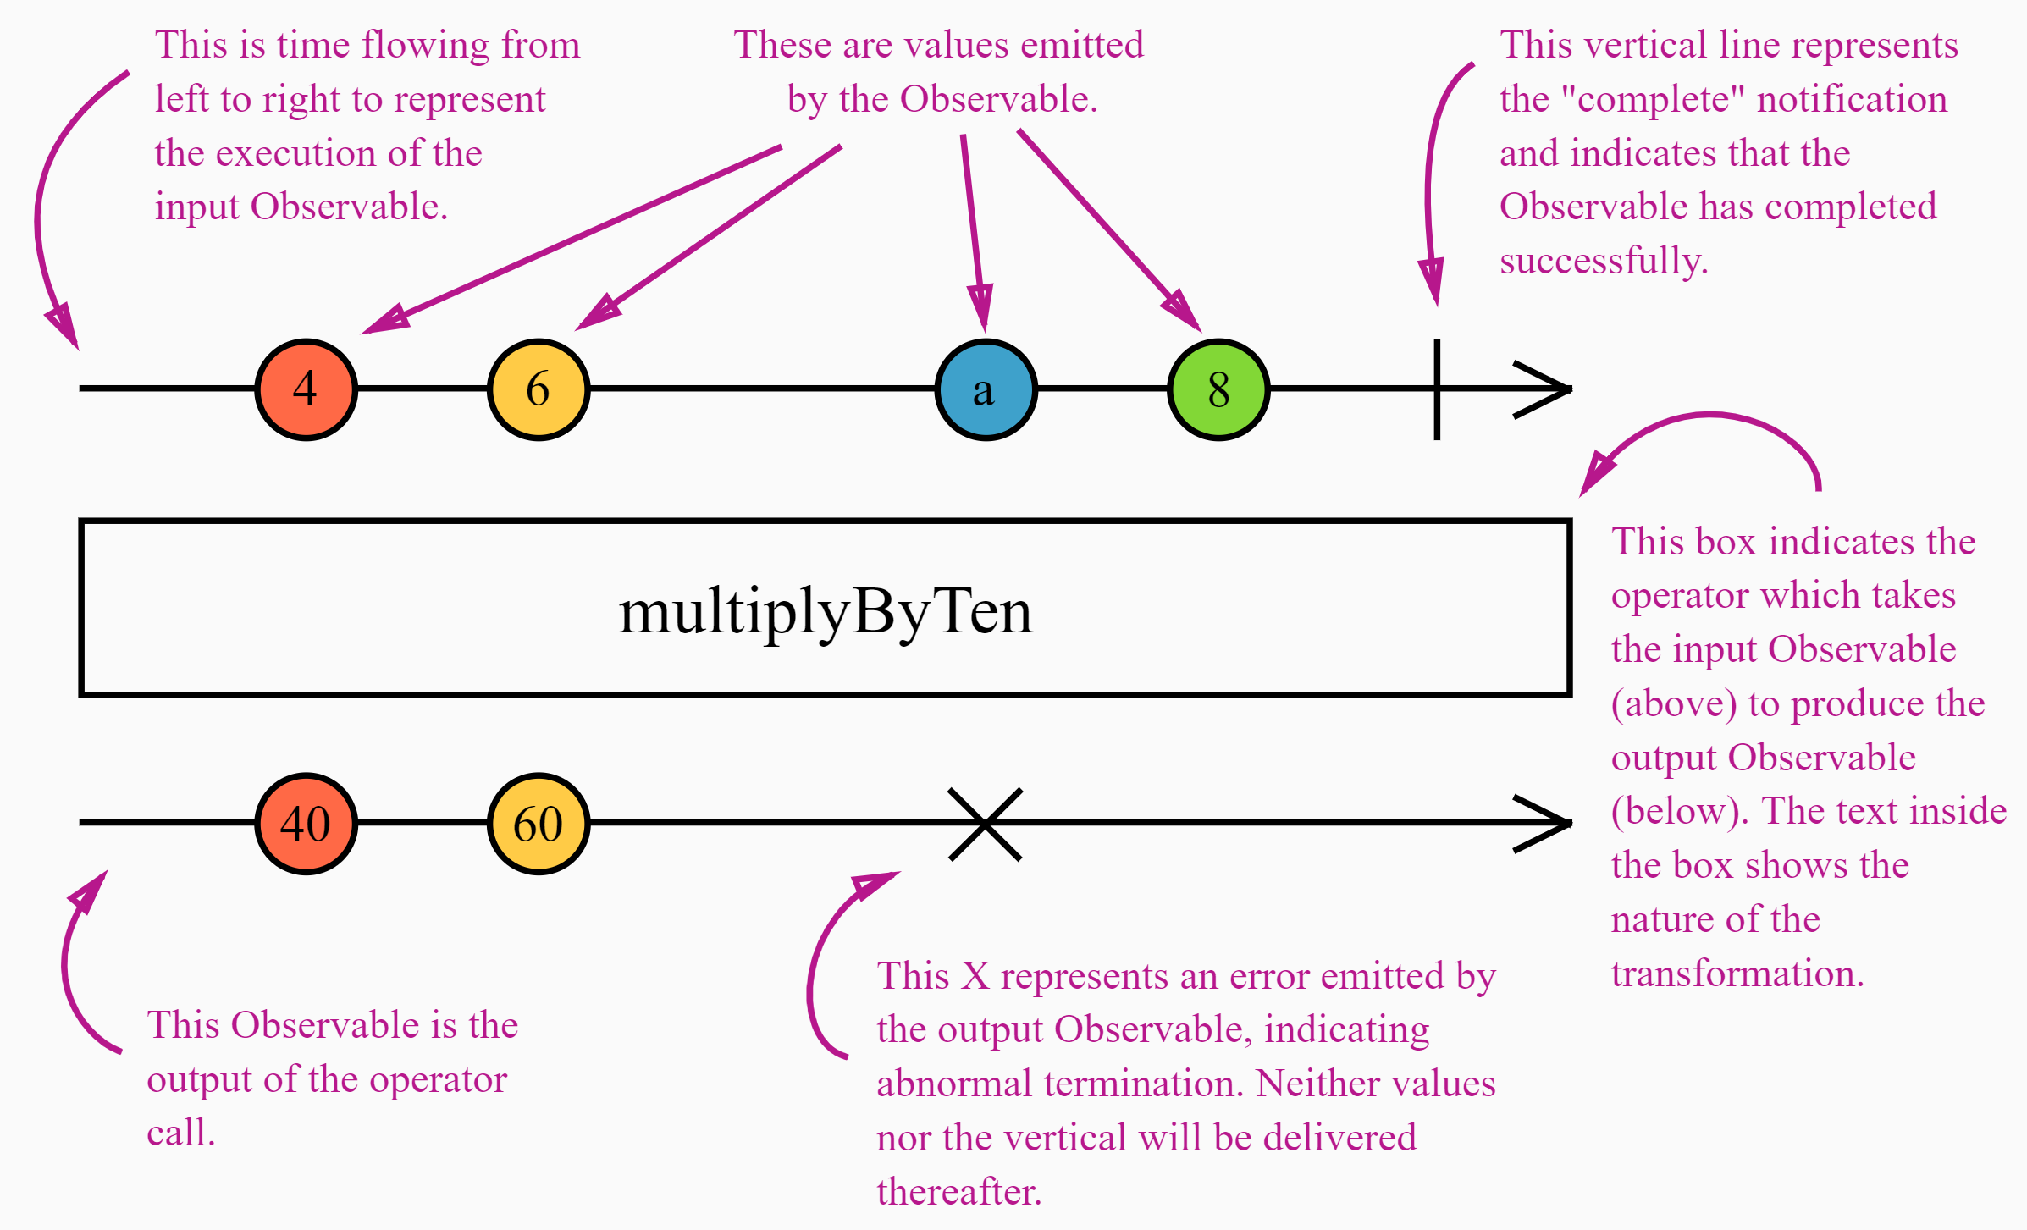
Marble Diagram https://rxjs-dev.firebaseapp.com/guide/operators
Many RxJS Operators are related to time. They may delay(), sample(), throttle(), or debounce() value emissions in different ways.
Marble Diagrams are visual representations of how operators work. They include:
the input Observables,
the operator and its parameters, and
the output Observable.
In a Marble Diagram, time flows to the right, meaning the marbles on the left are older.
The diagram describes how marbles (values) are emitted on the Observable execution.

Slide 12
RxJS – Core Concepts - Overview https://www.learnrxjs.io/ https://angular.io/guide/rx-library#the-rxjs-library
Concept | Definition
Observable | Represents the idea of an invokable collection of future values or events.
Observer | A collection of callbacks that waits for values delivered by the Observable.
Subscription | Represents the execution of an Observable. Primarily useful for cancelling the execution.
Operators | Functions that enable a functional programming style to deal with collections (map(), filter(), concat(), reduce()).
Subject | Equivalent to an EventEmitter. Used to multicast a value or event to multiple Observers.
Schedulers | Centralized dispatchers to control concurrency. Allows coordination when computation happens on setTimeout or requestAnimationFrame.

Slide 13
RxJS - Observables https://rxjs-dev.firebaseapp.com/guide/observable
Observables are Lazy-Push collections. Lazy-Push - values are only updated when asked for.
Observable vs Promise: An Observable deals with a collection, while a Promise deals with just one value/object.
Observables are not like EventEmitters nor are they like Promises for multiple values.
Pull and Push relationships.
Pull – the consumer pulls data when it wants.
Push – The producer Pushes data when a change is made.
 | Single value | Multiple (collection)
Pull | Function | Iterator
Push | Promise(Producer) | Observable(Producer)
 | Producer | Consumer
Pull | Passive – sends data only when requested | Active – requests data as needed.
Push | Active – Sends data when a change occurs | Passive – reacts to data received.

Slide 14
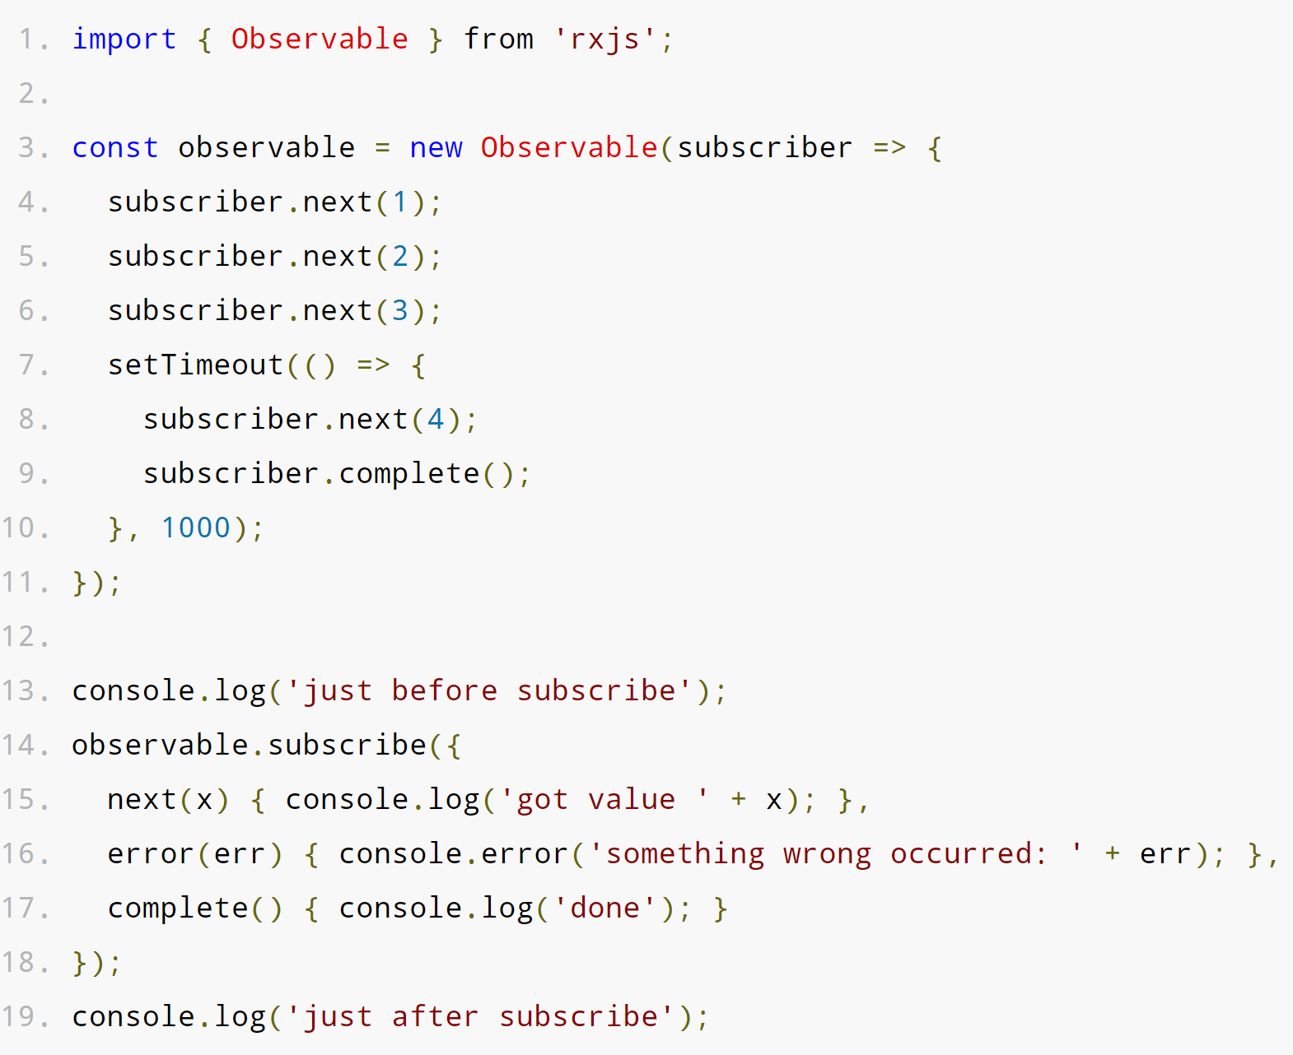
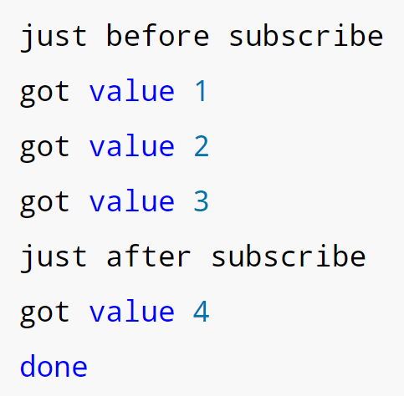
RxJS - Observables https://rxjs-dev.firebaseapp.com/guide/observable
An Observable can return multiple values over time. Subscribing to an Observable is just like calling a Function.
In this RxJS example, we:
(Line 1)import Observable from the RxJS Library.
(Lines 3-11)Create an Observable collection which has one parameter (using a lambda function).
The Observable actions are invoked in order.
.next() is invoked with 1, 2, and 3,
then execution waits 1 second with setTimeout() and adds 4.
Finally, the observable is marked .complete().
(Line 14) Subscribe to the Observable.
(Line 15-17) Observables only return:
next(x) iterates over the Observable values.
error(err) catches any error and stops further execution.
complete() is used for clean-up after all desired values have been iterated over
The result of this code is:

Slide 15
RxJS - Observables https://rxjs-dev.firebaseapp.com/guide/observable
The Observable is Lazy-loaded. It is not invoked until it is Subscribed to on line 14.
At that point it is initialized, iterated over, and its values are printed to the console.
Observables can run synchronously or asynchronously.
function() means "give me one value synchronously"
observable.subscribe() means "give me all values, either synchronously or asynchronously"
The result of this code is:

Slide 16
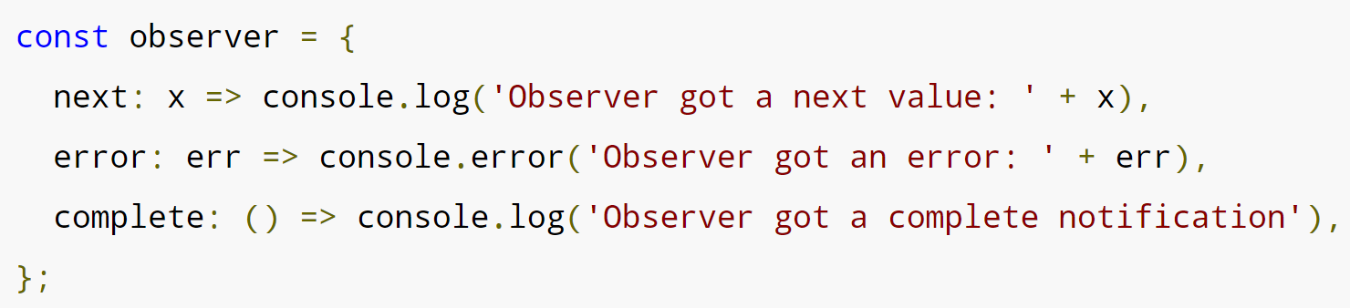
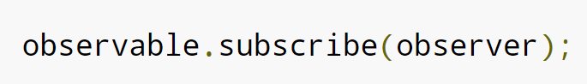
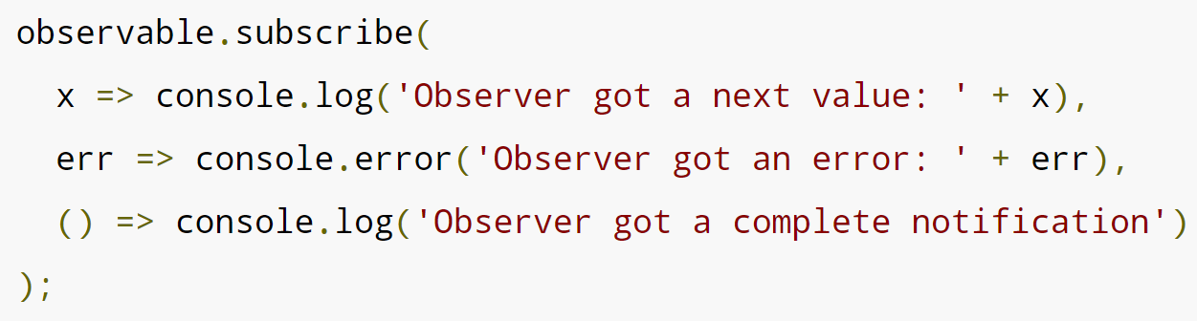
RxJS – Observers (next(), error(), complete()) https://rxjs-dev.firebaseapp.com/guide/observer
Observers are a set of three RxJS callbacks that consume the values delivered by an Observable. There is one callback for each type of notification delivered by the Observable: next(), error(), and complete().
You can create your own Observable and pass it to .subscribe() or you can provide each callback as arguments to .subscribe().
.subscribe() will instantiate an Observer object using the first callback argument as the next() observer.
Observers can have fewer than three callbacks. If one of the callbacks is missing, the Observable executes normally. The missing callbacks cause notifications to be ignored because they don't have a corresponding callback in the Observer.

Slide 17
RxJS – Higher Order Observables https://rxjs-dev.firebaseapp.com/guide/operators
A “Higher-Order Observable” is an Observable of another Observable. Here we have an Observable emitting strings that are URLs of files we want to see.
const fileObservable = urlObservable.pipe(
map(url => http.get(url)));
Work with Higher-Order Observables by “flattening” them. The concatAll() operator subscribes to each "inner" Observable that comes out of the "outer" Observable and copies all the emitted values until that Observable completes, then goes on to the next one. All the values are in that way concatenated.
const fileObservable = urlObservable.pipe(
map(url => http.get(url)),
concatAll());
Other Operators (called Join Operators) that are useful for flattening are:
mergeAll()
switchAll()
exhaust()

Slide 18
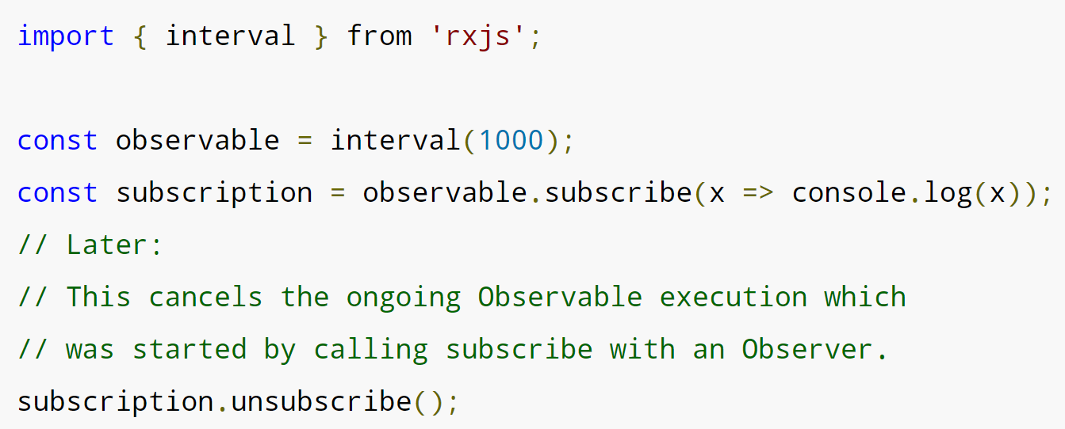
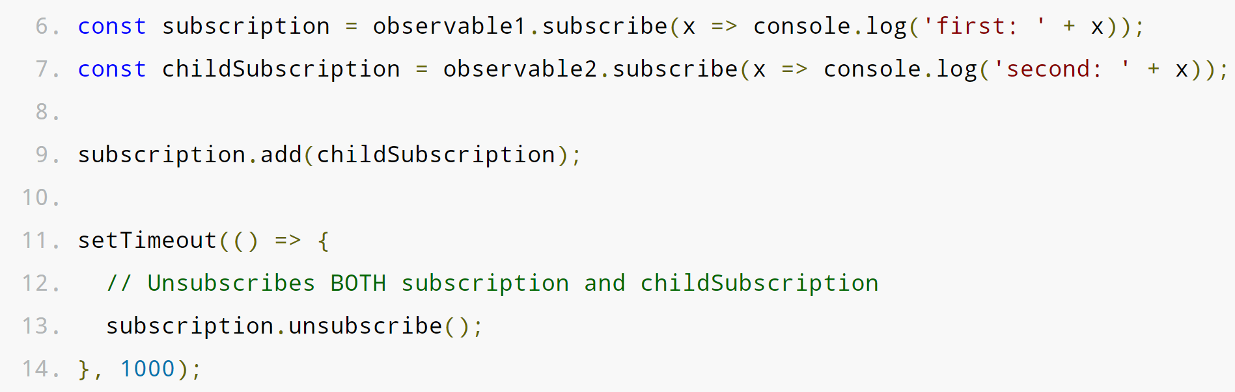
RxJS - Subscription https://rxjs-dev.firebaseapp.com/guide/subscription
A Subscription is an object that represents the execution of an Observable. A Subscription has one method, .unsubscribe(), which takes no argument. It only disposes of the resource held by the subscription.
Subscriptions can also be combined, so that a call to .unsubscribe() of the parent Subscription will unsubscribe .add()‘ed Subscriptions.

Slide 19
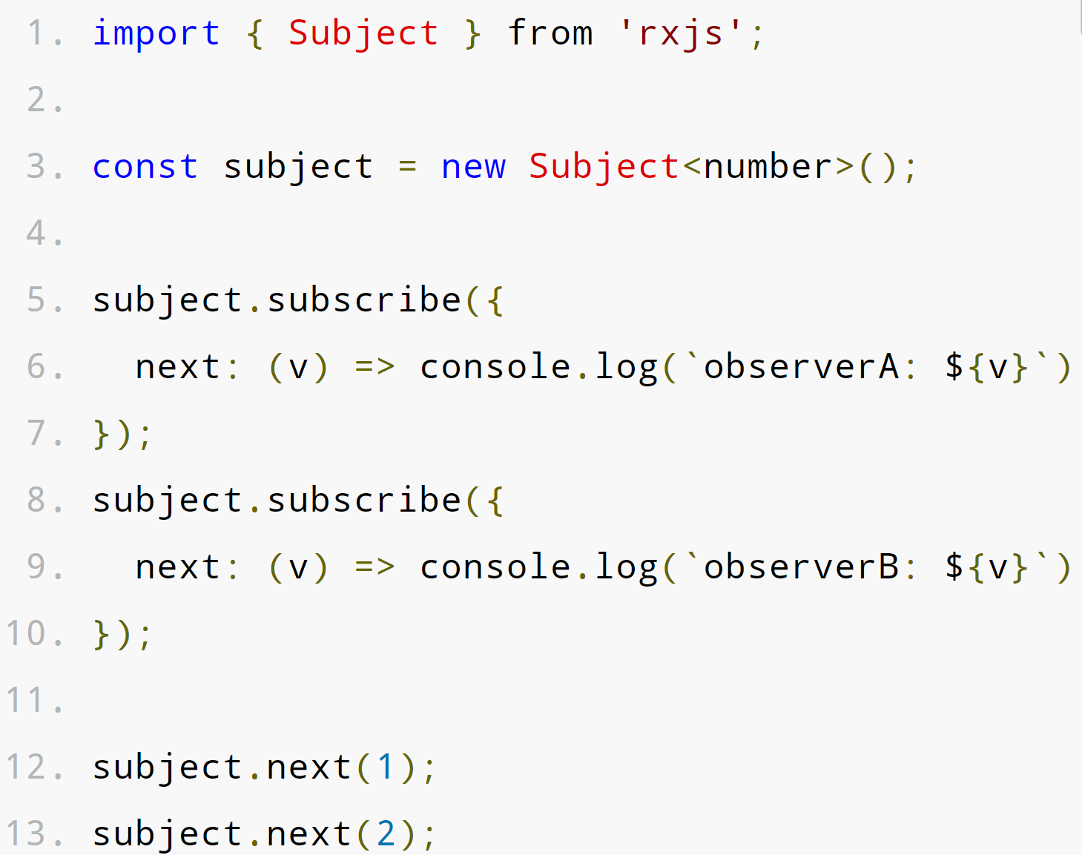
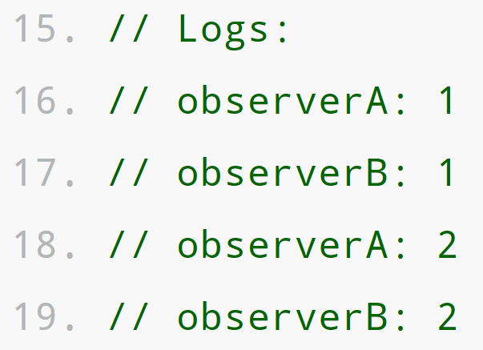
RxJS - Subject https://rxjs-dev.firebaseapp.com/guide/subject
A Subject is used for multicasting. Subjects are like Observables but can multicast to many Observers. Every Subject is an Observable. You can .subscribe() to a Subject by providing an Observer and it will start receiving values normally.
A Subject is also an Observer object with the methods next(v), error(e), and complete().
To feed a new value to the Subject, just call next(theValue), and that value will be multi-casted to the Observers registered to listen to the Subject.

Slide 20
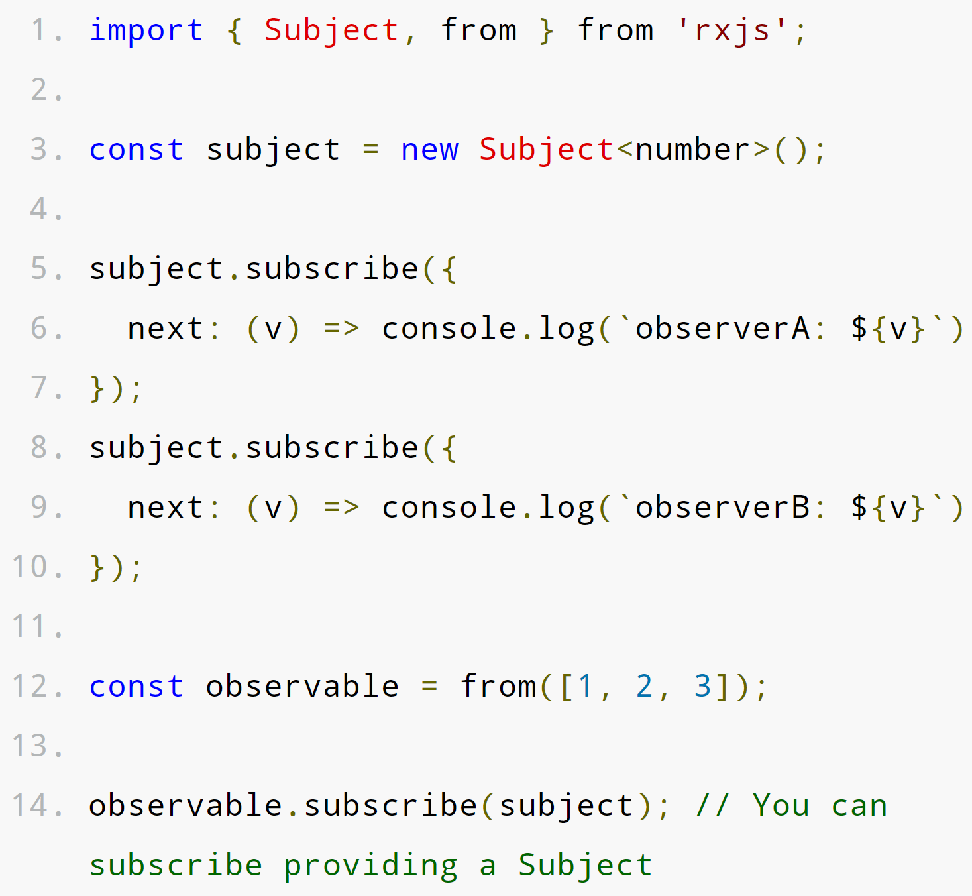
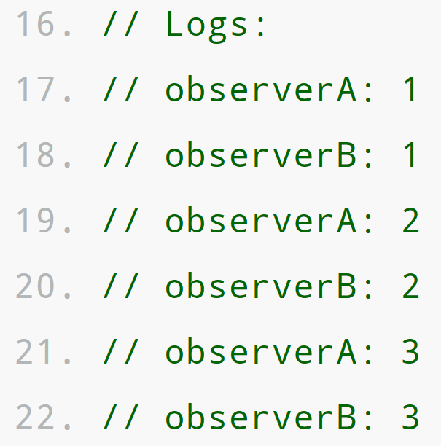
RxJS - Subject https://rxjs-dev.firebaseapp.com/guide/subject
You can also provide a Subject as the argument to the .subscribe() of any Observable. subscribe() will iterate over the Argument Subject and multicast the result to all subscribed Observers.
Subjects are the only way of sharing an Observable execution to multiple Observers.

Slide 21
RxJS - Schedulers https://rxjs-dev.firebaseapp.com/guide/scheduler
A scheduler controls when a subscription starts and when notifications are delivered. It lets you define in what execution context an Observable will deliver notifications to its Observer. It consists of three components.
Data Structure | Execution Context | Clock
A Scheduler knows how to store and queue tasks based on priority (or other criteria). | A Scheduler denotes where and when a task is executed: immediately or in another callback mechanism such as setTimeout or process.nextTick, or the animation frame). | A Schedulers virtual clock provides a notion of "time" by a getter method now(). Tasks being scheduled on a particular scheduler will adhere only to the time denoted by that clock.

Slide 22
RxJS – Scheduler Types https://rxjs-dev.firebaseapp.com/guide/scheduler
When using a Scheduler, you will identify one of the built-in Scheduler Types along with the Scheduler object. Each of these Scheduler Types can be created and returned by using static properties of the Scheduler object.
Scheduler Type | Usage
queueScheduler | Schedules on a queue in the current event frame (trampoline scheduler).
asapScheduler | Schedules on the micro task queue, which is the same queue used for promises. Will run after the current job, but before the next job.
asyncScheduler | Schedules work with setInterval. Use this for time-based operations.
animationFrameScheduler | Used for smooth browser animations. Schedules a task that will happen just before the next browser content ‘repaint’.

Slide 23
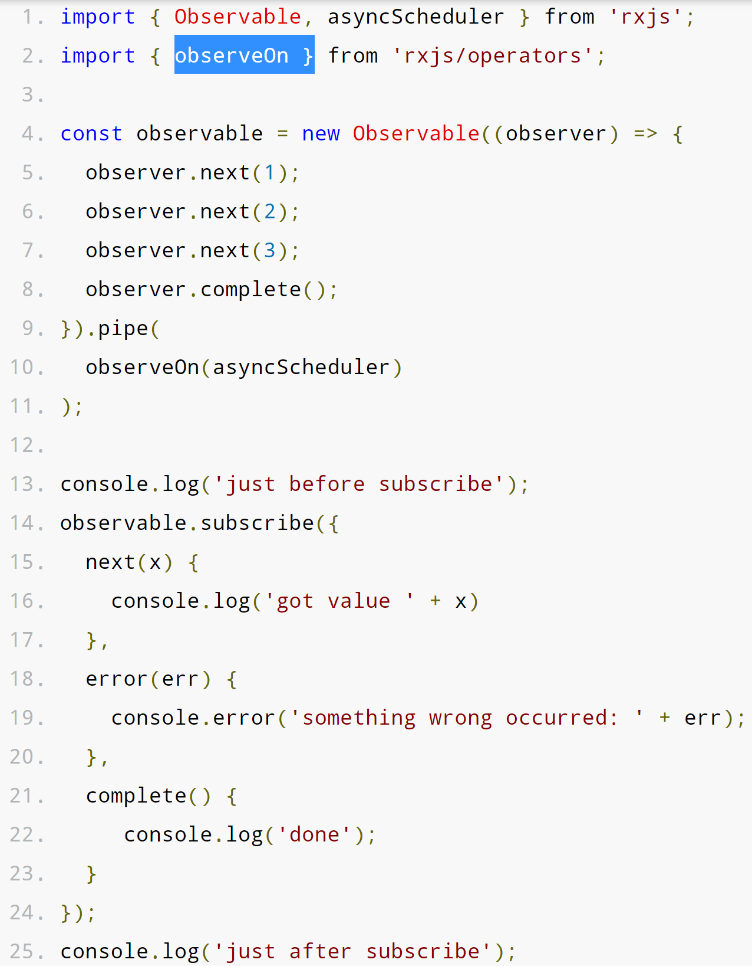
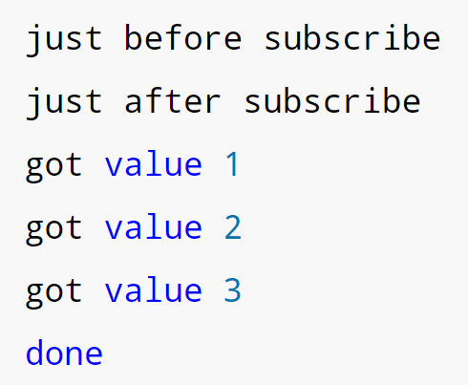
RxJS - Schedulers https://rxjs-dev.firebaseapp.com/guide/scheduler
//Output
The observeOn() Operator is used to attach the Scheduler Type to the Observable.
The Observable is unaffected other than having the new timing layered on top of its current output timing.
observeOn() takes 2 arguments.
A scheduler Type.
An (optional) delay in milliseconds.

Slide 24
Schedulers – Step-by-Step https://rxjs-dev.firebaseapp.com/guide/scheduler
//Output
To implement a Scheduler:
(Ln. 1)Import the Operators and Schedulers you need.
(Ln 4) Create an Observable to hold the values. Normally, you would return an Observable from a service function that you
(Ln 9) pipe() through observeOn() before being returned, and
(Ln 10) add the Scheduler of your choice as the first argument to observeOn().
subscribe() to the Observable and provide (at least) a next() function.

Slide 25
Step-by-step - Set-up a sample RxJS Development Environment https://medium.com/codingthesmartway-com-blog/getting-started-with-rxjs
Create a directory for this project and move into it with:
mkdir rxjs-test && cd rxjs-test
Create a NPM package.json to hold configuration settings with: (install Node Package Manager here.)
npm init –y
Install the NPM Webpack, Webpack Web Server, TypeScript, and TypeScript Loader with:
npm install rxjs webpack webpack-dev-server typescript ts-loader
Install the Webpack Command-Line Interface with
npm install webpack-cli --save-dev
In the package.json file, add a new section. This allows you to start the program with npm run start:
"scripts": { "start": "webpack-dev-server --mode development" },

Slide 26
Step-by-step - Set-up a sample RxJS Development Environment https://medium.com/codingthesmartway-com-blog/getting-started-with-rxjs
Set up Webpack. In the command line, create a new file called webpack.config.js in the root directory with:
touch webpack.config.js.
Add this to the file.
const path = require('path');
module.exports = {
entry: './src/index.ts',
devtool: 'inline-source-map',
module: {
rules: [ {
test: /\.tsx?$/,
use: 'ts-loader',
exclude: /node_modules/
}]
},
resolve: { extensions: [ '.tsx', '.ts', '.js' ] },
output: {
filename: 'bundle.js',
path: path.resolve(__dirname, 'dist')
}
};
Set up TypeScript. In the command line, create a new file called tsconfig.json in the root directory with:
Touch tsconfig.json.
Add this to the file (*make sure your “” are the same*):
{ "compilerOptions": { "outDir": "./dist/", "sourceMap": true, "noImplicitAny": true, "module": "es6", "moduleResolution": "node", "target": "es6", "allowJs": true, " lib " : [ "es2017", "dom" ] } }

Slide 27
Step-by-step - Set-up a sample RxJS Development Environment https://medium.com/codingthesmartway-com-blog/getting-started-with-rxjs
Set up your HTML file. In the command line, create a new file called index.html in the root directory with:
Touch index.html.
Add the following to the .html file
<!DOCTYPE html>
<html lang="en">
<head>
<meta charset="UTF-8">
<meta name="viewport" content="width=device-width, initial-scale=1.0">
<meta http-equiv="X-UA-Compatible" content="ie=edge">
<title>RxJS Demo</title>
</head>
<body>
<h1>RxJS Demo</h1>
<div>
<ul id="list"></ul>
</div>
<script src="/bundle.js"></script>
</body>
</html>
In the command line, create a new file called index.ts in the root directory with:
Touch index.ts.
Add this text to the index.ts file.
import { Observable } from 'rxjs';
var observable = Observable.create((observer:any) => {
observer.next('Hello World!');
observer.next('Hello Again!');
observer.complete();
observer.next('Bye');
})
observable.subscribe(
(x:any) => logItem(x),
(error: any) => logItem ('Error: ' + error),
() => logItem('Completed')
);
function logItem(val:any) {
var node = document.createElement("li");
var textnode = document.createTextNode(val);
node.appendChild(textnode);
document.getElementById("list").appendChild(node);
}

Slide 28
Step-by-step - Set-up a sample RxJS Development Environment https://medium.com/codingthesmartway-com-blog/getting-started-with-rxjs
Now you can start the sample app with:
npm run start
.

